Slide 1
Holistic Health
Khari Pettigrew
HW 499: Capstone Health and Wellness
Purdue Global University

Slide 2
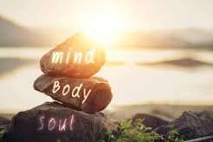
What is Holistic Health?
According to Holistic Council (2026), “Holistic Health is the practice of working with the “whole” person to improve overall health, energy, and outlook. Rather than a disease based approach to health care–see a doctor, take a pill, rinse, and repeat–a holistic practitioner uses a wellness-based model to treat everything – mind, body, spirit, and beyond.”
ISTOCKPHOTO
(2025)

Slide 3
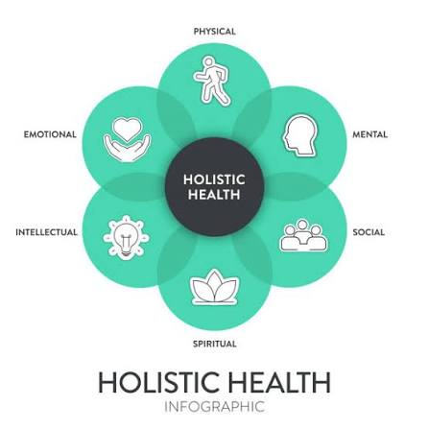
WHAT DO YOU KNOW ABOUT HOLISTIC HEALTH?
ISTOCKPHOTO (2025)

Slide 4
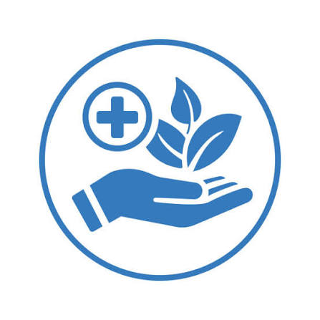
WHAT DIFFERENT AREAS DO HOLISTIC HEALTH AND MODERN MEDICINE EXCEL?
ISTOCKPHOTO
(2026)

Slide 5
HOLISTIC HEALTH VS. MODERN MEDICINE AREA OF EXCEL
Holistic Health: Thieme-Burdette (2026), Holistic Health excel at Symptom relief, Identifying root cause, Supplements, herbs, homeopathy, and food as medicine.
Modern Medicine: Thieme-Burdette (2026), Acute and emergency care, Pharmaceuticals and drug interactions, and Surgical procedures.

Slide 6
Concepts, Principles and Methods of Interest
7 Dimensions of Wellness
Holistic Diets for Healing
Spiritual Healing
Psychological Healing

Slide 7
7 Dimensions of Wellness
Emotional: “Feelings are the lens through which people view the world, and the ability to be aware of and direct one’s feelings helps to create balance in life.” (ICAA, 2025)
Intellectual, cognitive: “Engaging in creative pursuits and intellectually stimulating activities is a proven approach to keeping minds alert and interested.” (ICAA, 2025)
Physical: “The goal of living independently is one shared by many people, and physical wellness is necessary to achieve this.” (ICAA, 2025)
Professional, vocational: “Work that utilizes a person’s skills while providing personal satisfaction is valuable for society as well as the individual.” (ICAA, 2025)

Slide 8
7 Dimensions of Wellness
Social: “Social interactions with family, friends, neighbors and chosen peer groups can be valuable for maintaining health.” (ICAA, 2025)
Spiritual: “Living with meaning and purpose in life, guided by personal values, is key to feelings of well-being and connection to the larger world.” (ICAA, 2025)
Environmental: “Surrounded by natural and man-made environments, good stewardship means respecting resources by choosing “green” processes that re-use and recycle goods.” (ICAA, 2025)

Slide 9
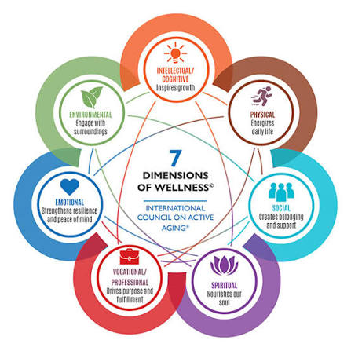
Exercise!
Take 15 minutes to get into back in your breakout groups, and discuss which of the 7 dimensions you feel you excel at the most, and which do you struggle with.
ICAA (2025)

Slide 10
Holistic Diets for Healing
Leafy green vegetables: “Reduce inflammation and enhance your immune system.” (SSI, 2025)
Garlic: “Helpful for recovery from surgery or bacterial infections.” (SSI, 2025)
Shellfish: “Immune system and promotes healing.” (SSI, 2025)
Eggs: “Eggs also contain healing minerals like iron and zinc, as well as vitamins B12 and A.” (SSI, 2025)

Slide 11
Holistic Diets for Healing
Oily fish: “Acts as an anti-inflammatory and painkiller. It provides protein, iron, zinc, B vitamins and selenium, which reduces inflammation and promotes healing.” (SSI, 2025)
Milk: “Source of vitamin K and protein, which help your recovery process.” (SSI, 2025)
Oats: “Help your body regulate blood sugar and cholesterol levels.” (SSI, 2025)

Slide 12
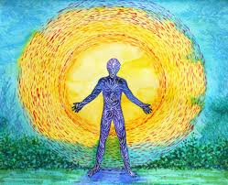
Spiritual Healing
According to Woods (2025), “Spiritual healing is a holistic approach to healing that combines the mind, body, and spirit to promote physical, emotional, and spiritual well-being.”
ISTOCKPHOTO (2025)

Slide 13
Types of Spiritual Healing
Energy healing: This type of healing involves the transfer of energy from the healer to the patient to promote balance and harmony. (Woods, 2025)
Chakra healing: This type of healing focuses on the seven chakras or energy centers in the body and aims to balance and align them for optimal well-being. (Woods, 2025)
Reiki: This is a form of Reiki training that involves the transfer of energy from the healer to the patient to promote relaxation and reduce stress. (Woods, 2025)
Meditation: Meditation is a powerful tool for promoting relaxation, reducing stress, and improving overall well-being. (Woods, 2025)

Slide 14
Benefits of Spiritual Healing
Reduced stress and anxiety (Woods, 2025)
Improved mood and emotional well-being (Woods, 2025)
Improved physical health and well-being (Woods, 2025)
Increased sense of connection and community (Woods, 2025)
Improved mental clarity and focus (Woods, 2025)
Increased sense of purpose and direction (Woods, 2025)

Slide 15
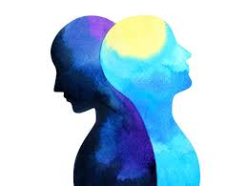
Psychological Healing
According to Nicolas (2025), “Mental healing isn’t about “fixing” yourself—it’s about restoring balance, building resilience, and finding peace. It may involve working through painful emotions, changing harmful thought patterns, or learning new ways to cope with stress.”
ISTOCKPHOTO (2026)

Slide 16
Types of Psychological Healing
Journaling: Write down thoughts and emotions to gain clarity. (Nicolas, 2025)
Creative outlets: Painting, music, or writing can provide healthy expression. (Nicolas, 2025)
Breath work: Deep breathing reduces stress and calms the nervous system (Nicolas, 2025)
Gratitude lists: Shifting focus to what’s positive fosters hope. (Nicolas, 2025)

Slide 17
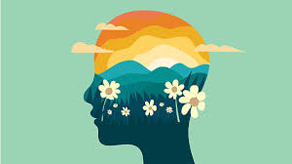
Benefits of Psychological Healing
Reduces psychological distress
Resolves past trauma
Builds lifelong coping skills.
ISTOCKPHOTO (2026)

Slide 18
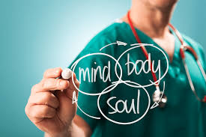
Exercise!
Separate into different boxes. If the practice is a spiritual healing practice put it into the spiritual healing box. If the practice is a psychological healing practice put it into the psychological healing box.
ISTOCKPHOTO (2025)

Slide 19
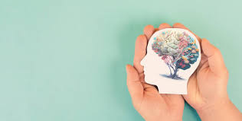
Exercise!
Journaling
Chakra healing
Reiki
Breath work
Energy healing
Gratitude lists
ISTOCKPHOTO (2026)

Slide 20
Exercise
Spiritual Healing | Journaling Breath work Gratitude lists
Psychological Healing | Chakra healing Reiki Energy healing

Slide 21
QUIZ

Slide 22
In the 7 dimensions of wellness what is the definition of spiritual?
Engaging in creative pursuits and intellectually stimulating activities is a proven approach to keeping minds alert and interested.
Living with meaning and purpose in life, guided by personal values, is key to feelings of well-being and connection to the larger world.
Feelings are the lens through which people view the world, and the ability to be aware of and direct one’s feelings helps to create balance in life.
Surrounded by natural and man-made environments, good stewardship means respecting resources by choosing “green” processes that re-use and recycle goods

Slide 23
ANSWER
B

Slide 24
How does leafy green vegetables help your body heal?
Reduce inflammation and enhance your immune system
Source of vitamin K and protein, which help your recovery process
Contain healing minerals like iron and zinc, as well as vitamins B12 and A
Acts as an anti-inflammatory and painkiller

Slide 25
Answer
A

Slide 26
How does oily fish help your body heal?
Reduce inflammation and enhance your immune system
Source of vitamin K and protein, which help your recovery process
Contain healing minerals like iron and zinc, as well as vitamins B12 and A
Acts as an anti-inflammatory and painkiller

Slide 27
Answer
D

Slide 28
REFERENCES:
Holistic Council. (2026). What is holistic health? • Holistic Council. https://holisticcouncil.org/what-is-holistic-health/
ICAA. (2025). The seven dimensions of Wellness - International Council on Active Aging®. https://www.icaa.cc/activeagingandwellness/wellness.htm
Istock. (2025). Bags of dried herbs. IStock. https://www.istockphoto.com/photo/medical-herbs-gm173586199-7977172
Nicolas, S. (2025, September 1). How to start to heal mentally: A practical guide. https://tampacounselingandwellness.com/mh-blogs/how-to-start-to-heal-mentally/
SSI. (2025). Top 10 foods to help you heal - the Southeastern Spine Institute. https://southeasternspine.com/top-10-foods-to-help-you-heal/
Thieme-Burdette, M. (2026). Explained: Holistic vs modern western medicine » global autoimmune institute. https://www.autoimmuneinstitute.org/articles/explained-holistic-vs-modern-western-medicine/
Woods, J. (2025, May 22). What is the concept of spiritual healing? | souladvisor. https://www.souladvisor.com/your-sanctuary/article/what-is-spiritual-healing-unlocking-the-power-of-the-mind-and-body-soul

Slide 29
THANK YOU!!!

