Slide 1
Herbal Healing
Khari Pettigrew
HW 499: Capstone Health and Wellness
Purdue Global University

Slide 2
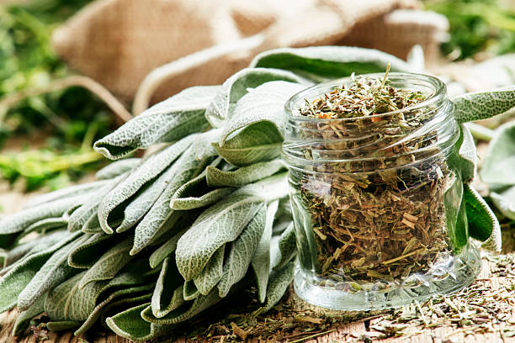
What is herbal healing?
According to John Hopkins (2025), “Plant-based products used to treat diseases or to maintain health.”
ISTOCKPHOTOS (2025)

Slide 3
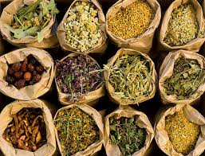
What do you know about herbal healing?
ISTOCKPHOTOS (2025)

Slide 4
History of herbal healing?
According to Petrovska (2012), “The oldest written evidence of medicinal plants’ usage for preparation of drugs has been found on a Sumerian clay slab from Nagpur, approximately 5000 years old. It comprised 12 recipes for drug preparation referring to over 250 various plants, some of them alkaloid such as poppy, henbane, and mandrake.”
Many TCM (Traditional Chinese Medicines) uses herbal medicine as a foundational part of treating people.
Even today we use different herbal medicine to heal many different illnesses and problems.

Slide 5
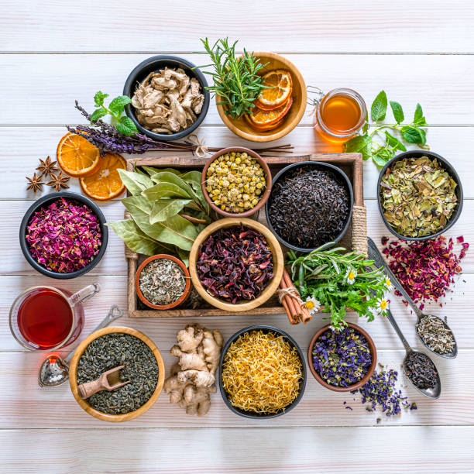
Herbs of interest!!
Chamomile
Ginger
Elderberry
Valerian
Turmeric
Milk thistle
ISTOCKPHOTO (2025)

Slide 6
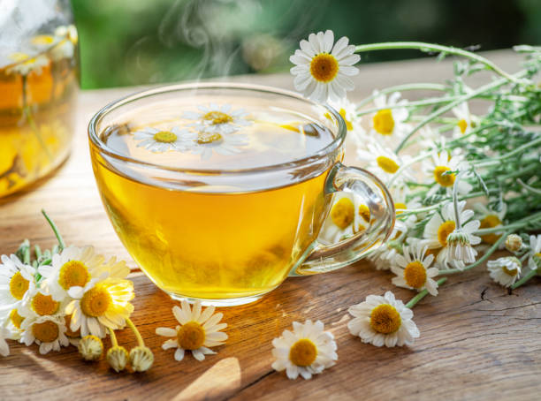
Chamomile
Origin: Southern and Eastern Europe/ Western/Northern Asia
Healing Effects: According to the AANMC (2025), “Chamomile (Matricaria chamomilla) is a well-established botanical known for its calming/anxiolytic properties. Clinical studies have demonstrated its effectiveness in improving sleep quality and reducing symptoms of moderate to severe generalized anxiety.
ISTOCKPHOTO, (2025)

Slide 7
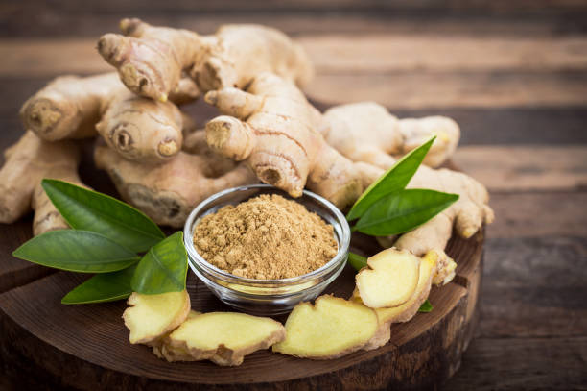
ginger
Origins: Maritime Southeast Asia
Healing effects: According to the AANMC (2025), “Ginger (Zingiber officinale) is widely recognized for its antiemetic (anti-nausea) properties, with clinical studies supporting its specific efficacy in reducing nausea and vomiting associated with pregnancy and chemotherapy.”
ISTOCKPHOTO, (2025)

Slide 8
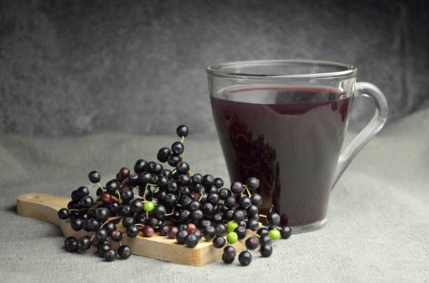
Elderberry
Origins: Europe, Asia, and North America.
Healing Effects: According to the AANMC (2025), “Elderberry (Sambucus nigra). Elderberry has been shown in clinical and in vitro studies to reduce the severity and duration of upper respiratory tract infections, including the common cold and influenza.”
ISTOCKPHOTO,
(2025)

Slide 9
Exercise!!
Take 15 min to find recipes that you would use these 3 herbs. After the 15 minutes share with the class in the chat.

Slide 10
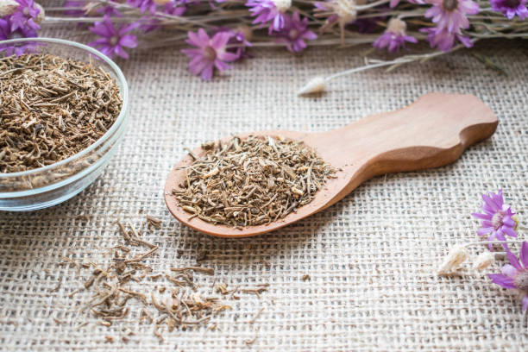
Valerian
Origins: Grasslands and damp woodlands of Europe and Asia
Healing effects: According to the AANMC (2025), “ Valerian (Valeriana officinalis). Valerian is a medicinal root traditionally used for the management of insomnia and sleep disturbances.”
ISTOCKPHOTO,
(2025)

Slide 11
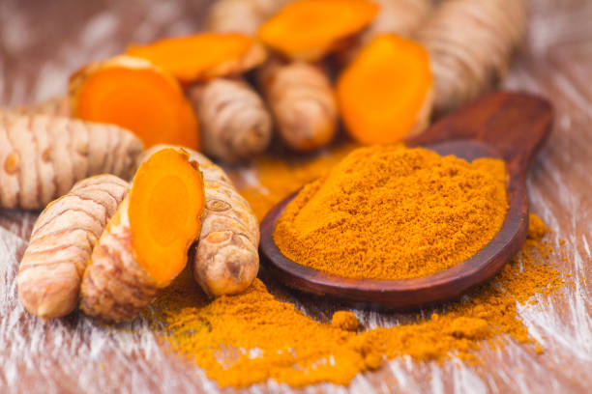
Turmeric
Origins: the Indian subcontinent and tropical Southeast Asia
Healing effects: According to the AANMC (2025), “Turmeric (Curcuma longa). Turmeric is a bright orange root commonly often used in traditional cooking and wellness juices. Turmeric contains curcumin as its principal bioactive compound. Curcumin exhibits potent anti-inflammatory and analgesic properties.”
ISTOCKPHOTO,
(2025)

Slide 12
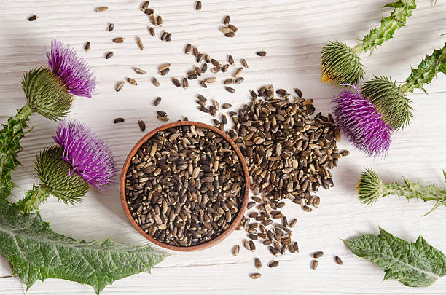
Milk thistle
Origins: the Mediterranean region of Europe
Healing effects: According to the AANMC (2025), “Milk thistle (Silybum marianum). Milk thistle is a well-known herbal remedy due to its liver-supportive properties.”
ISTOCKPHOTO,
(2025)

Slide 13
Questions?

Slide 14
Questions?
Which herb can be used for anti-nausea?
Milk thistle
Chamomile
Elderberry
Ginger

Slide 15
GINGER

Slide 16
Questions?
What herb comes from Grasslands and damp woodlands of Europe and Asia?
Chamomile
Valerian
Turmeric
Milk thistle

Slide 17
Valerian

Slide 18
Questions?
What herb help with Liver-health?
Milk thistle
Elderberry
Ginger
Turmeric

Slide 19
Milk thistle

Slide 20
References:
AANMC. (2025, May 20). Natural options to enhance your well-being. https://aanmc.org/natural-remedies/herbal-remedies-for-natural-healing/
Istock. (2025). Bags of dried herbs. iStock. https://www.istockphoto.com/photo/medical-herbs-gm173586199-7977172
John Hopkins. (2025). Herbal medicine | johns hopkins medicine. https://www.hopkinsmedicine.org/health/wellness-and-prevention/herbal-medicine
Petrovska, B. B. (2012, January). Historical Review of Medicinal Plants’ usage. Pharmacognosy reviews. https://pmc.ncbi.nlm.nih.gov/articles/PMC3358962/

Slide 21
Thank you

