Slide 1
Benefits of Complementary and Integrative Modalities
Khari Pettigrew
HW 499: Capstone Health and Wellness
Purdue Global University

Slide 2
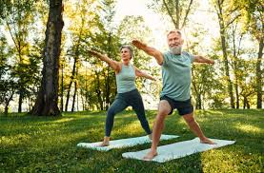
What is Complementary Medicine?
According to the Cleveland Clinic (2026), “Complementary medicine is a term used to describe types of treatments you may receive along with traditional Western medicine.”
ISTOCKPHOTO (2025)

Slide 3
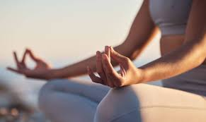
HAVE ANYONE EVER TRIED COMPLEMENTARY MEDICINE OR MODALITIES?
ISTOCKPHOTO (2025)

Slide 4
Modalities of Interest!!
Mindful Meditation
Reiki
Yoga
Tai Chi
Acupuncture
Chiropractic

Slide 5

BREAKOUT GROUP!!!
We will break into groups of three to four, and take 15 min to research the history of one the modalities.
Then we come back discuss your findings.
ISTOCKPHOTO
(2025)

Slide 6
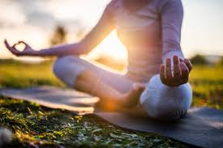
Mindful Meditation
Origins: According to Singh (2023), “Mindfulness is a major feature of all Indian religious and philosophical traditions. In Indian philosophy, a core epistemological concept is pramaana (proof), since true knowledge is considered the route to liberation of the self from the cycle of existence (samasara) and suffering (dukkha).”
Benefits: Reduce stress, depression and anxiety.
ISTOCKPHOTO
(2025)

Slide 7
Do anyone have stories of practicing mindful meditation?

Slide 8
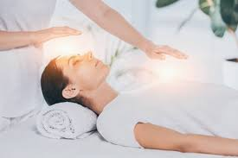
Reiki
Origins: According to EBSCO (2024), “The word reiki comes from the Japanese words rei, meaning “universal,” and ki, meaning “life energy.” The term refers to a form of spiritual healing that involves holding one’s hands on or above another’s body in order to supposedly manipulate energy fields.”
“There are two principal stories regarding the origin of Reiki. In both versions, the method was invented in Japan by Mikao Usui (1865-1926).”
Benefits: Relieves anxiety and depression, pain management, and fatigue reduction
ISTOCKPHOTO (2024)

Slide 9
What are your thoughts on Reiki?

Slide 10
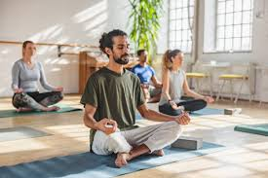
YOGA
Origins: According to Google Arts & Culture (2018), “Yoga can be traced to northern India over 5,000 years ago. The word yoga was first mentioned in ancient scared text called the Rig Veda.”
Benefits: Increased flexibility, enhanced core strength, reduced stress and anxiety.
ISTOCKPHOTO (2024)

Slide 11
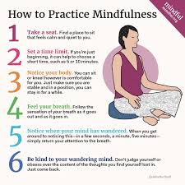
EXERCISE!!!
Mindfulness.org (2026)

Slide 12
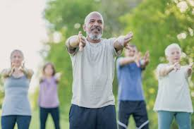
Tai Chi
Origins: According to Rising Moon Tai Chi (2017), "Historical records state that Zhang Sanfeng (Chang San Feng) (1279-1368) studied under a Taoist recluse living in northwest China. Zhang Sanfeng is credited with developing a Wudang Sect in Wudang Mountain in the early Ming Dynasty (1368) and gradually had a large following. After years of the study of Taoism, he made a great contribution to promoting Taoist theory. He also developed a number of bare hand martial arts which gave rise to ‘tai chi’.”
Benefits: Improves physical stability, muscular strength, cardiovascular health, and mental well-being.
ISTOCKPHOTO (2025)

Slide 13
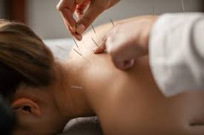
Acupuncture
Origins: According to Dr. Ananya Mandal (2023), “Earliest documentation that refers to acupuncture procedures is The Yellow Emperor’s Classic of Internal Medicine, dating from about 100 BCE. In this book the knowledge is in the form of questions made by the Emperor that his learned minister, Chhi-Po has replied to.”
Benefits: Relieves chronic pain, reduces stress and anxiety, and stimulates the body's natural healing responses
ISTOCKPHOTO (2025)

Slide 14
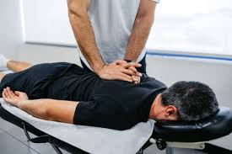
Chiropractic
Origins: According to Sportelli (2019), “Chiropractic was founded in 1895 in Davenport, Iowa, by Daniel David (D.D.) Palmer, a magnetic healer. Palmer theorized that misaligned spinal vertebrae, which he called subluxations, blocked nerve signals and caused disease.”
Benefits: Relieves chronic back and neck pain, a reduction in tension headaches, and improved joint mobility.
ISTOCKPHOTO (2025)

Slide 15
QUIZ

Slide 16
Who developed a number of bare hand martial arts which gave rise to ‘tai chi’?
Chen Wangting
Zhang Sanfeng
Yang Luchan
Cheng Man-ch'ing

Slide 17
B:Zhang Sanfeng

Slide 18
Which Practice does spiritual healing that involves holding one’s hands on or above another’s body?
Yoga
Acupuncture
Chiropractic
Reiki

Slide 19
D:Reiki

Slide 20
Which practice Relieves chronic pain, reduces stress and anxiety, and stimulates the body's natural healing responses?
Mindful Meditation
Acupuncture
Chiropractic
Reiki

Slide 21
B:Acupuncture

Slide 22
Dr. Ananya Mandal, M. (2023, June 20). Acupuncture history. News. https://www.news-medical.net/health/Acupuncture-History.aspx
EBSCO CAM Review Board. (2024). Reiki: History: Research starters: EBSCO research. EBSCO. https://www.ebsco.com/research-starters/history/reiki
Google Arts & Culture. (2025). Explore the ancient roots of Yoga - Google Arts & Culture. Google. https://artsandculture.google.com/story/explore-the-ancient-roots-of-yoga/ywWBRDl92CPuJg?hl=en
Istock. (2025). Bags of dried herbs. iStock. https://www.istockphoto.com/photo/
Rising Moon Tai Chi. (2017). History of Tai Chi. https://www.risingmoontaichi.net/history-of-tai-chi
Singh, S. P. (2023, April). sakshi and dhyana: The origin of Mindfulness-based therapies. BJPsych bulletin. https://pmc.ncbi.nlm.nih.gov/articles/PMC10063990/
Sportelli, L. (2019, December). The Discovery, development and current status of the chiropractic profession. Integrative medicine (Encinitas, Calif.). https://pmc.ncbi.nlm.nih.gov/articles/PMC7238904/
Staff, M. (2026a, March 31). How to practice mindfulness. http://mindful.org/how-to-practice-mindfulness/

Slide 23
Thank You!!

